Slide 1















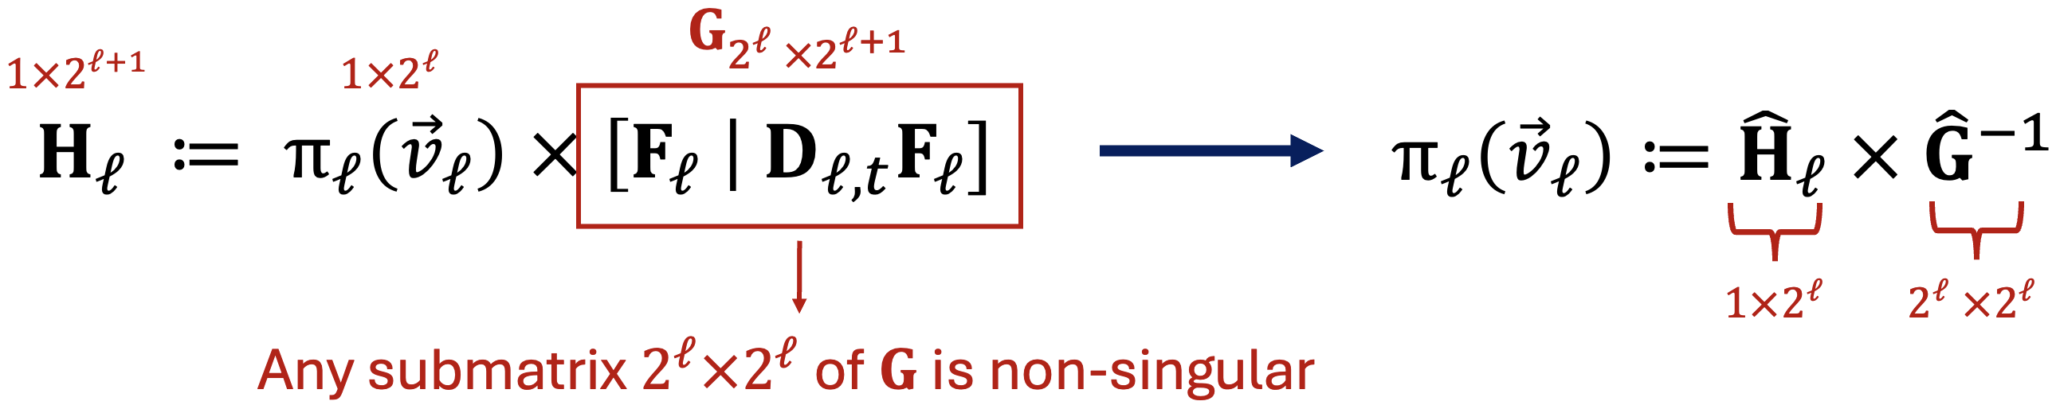
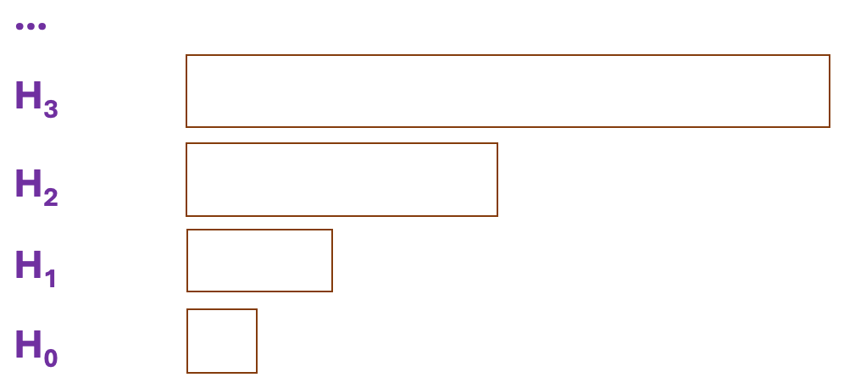
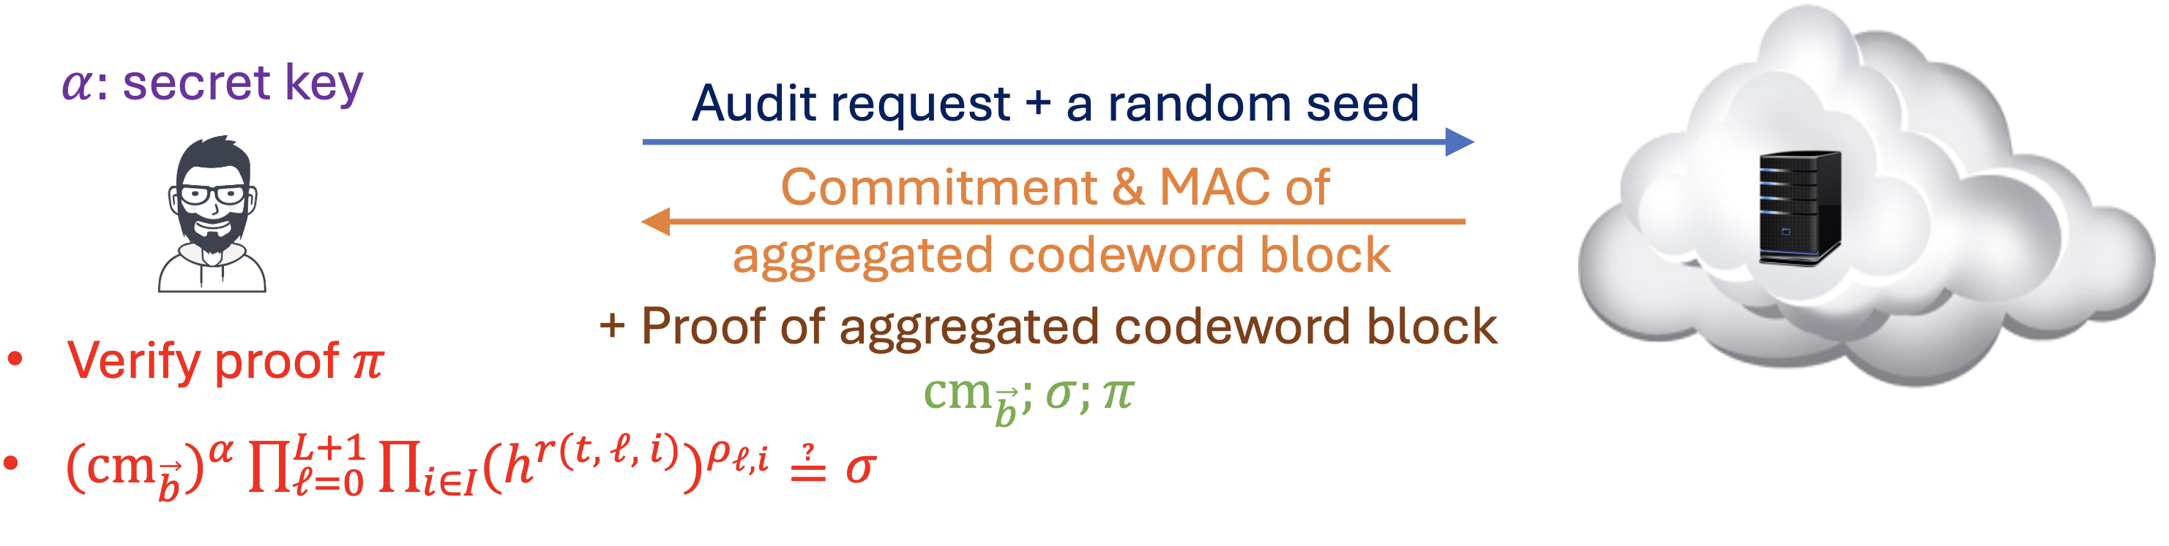

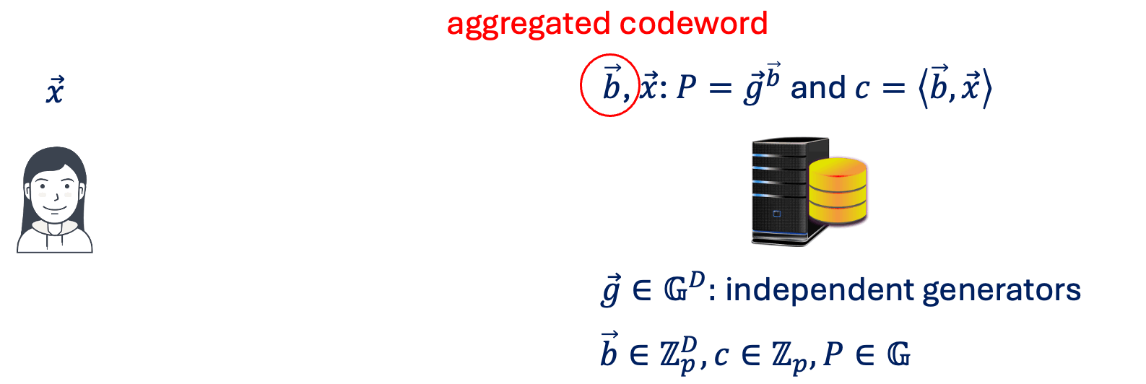


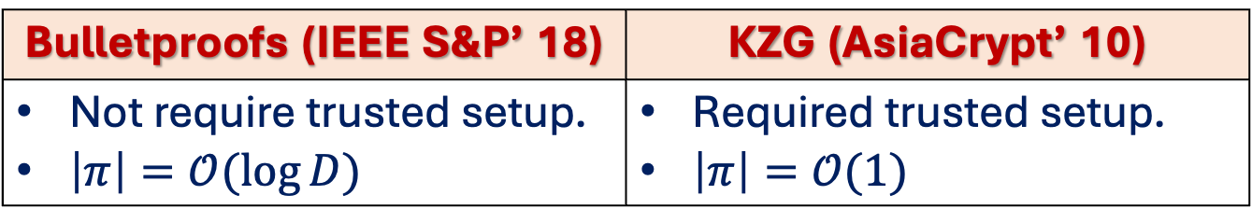
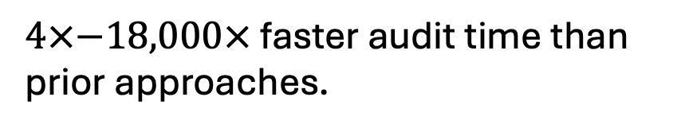
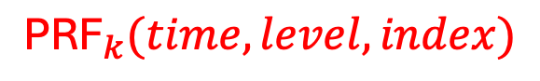

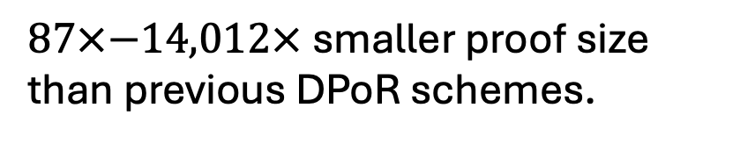
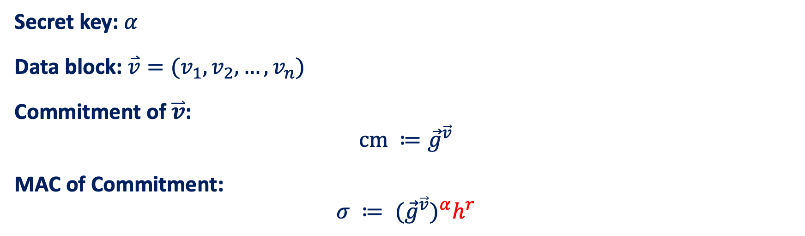
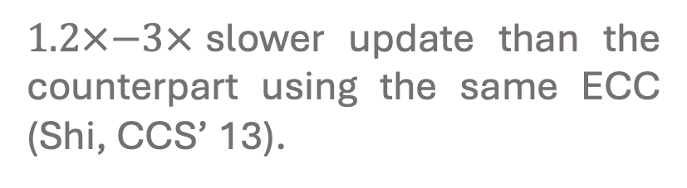
EFFICIENT DYNAMIC PROOF OF RETRIEVABILITY FOR COLD STORAGE*
Tung Le, Pengzhi Huang, Attila A. Yavuz, Elaine Shi, Thang Hoang
*Full Paper
1. OVERVIEW
2. PROOF OF RETRIEVABILITY
3. FEATURES
Error-Correcting Code.
FFT-based code.
Incrementally constructible.
Proof of Retrievability (PoR) allows a server to prove the possession of all data (audit) in an efficient manner.
Dynamic PoR (DPoR) schemes additionally support efficient update capability.
Homomorphic MAC. The authentication tags can be aggregated into a single tag according to some linear com- bination.
Storage-as-a service (STaaS)
We proposed and designed Porla:
Verifiable Computation Techniques.
KZG (AsiaCrypt’ 10).
Inner Product Argument in Bulletproofs (IEEE S&P’ 18).
Data loss can happen due to:
Hardware failures.
Adversarial behaviors.
Previous DPoRs | Our Work (Porla)
Low storage (USENIX’ 21) Fast update (CCS’ 13) Metadata privacy (JoC’ 17) | Small Proof Size Low Audit Time
Support Public Audit.
4. ERROR-CORRECTING CODE
5. PROOF OF POLYNOMIAL EVALUATION
Secret key: $α$
Data block: $\overset{⃑}{v}=(v_{1}, v_{2}, …, v_{n})$
Commitment of $\overset{⃑}{v}$:
$$cm ≔{\vec{g}}^{\vec{v}}$$
MAC of Commitment:
$$σ ≔ {({\vec{g}}^{\vec{v}})}^{α}h^{r}$$
$$\vec{g}∈𝔾^{n}$$
MAC
$${\text{PRF}}_{k}(time, level, index)$$
Codeword
Temporary Codeword
ICC operations are based on FFT butterfly circuit.
Our data structure includes:
Raw buffer U:
…
Bulletproofs (IEEE S&P’ 18) | KZG (AsiaCrypt’ 10)
Not require trusted setup. $\left|π\right|=𝒪(\log{D)}$ | Required trusted setup. $\left|π\right|=𝒪(1)$
Erasure code C:
…
Hierarchical Log H:
…
Data block
H₃
H₂
Codeword
H₁
Homomorphic MAC
H₀
6. EXPERIMENTS
7. CONCLUSION
Server: EC2 c6i.8xlarge, 16-core Intel Xeon Platinum 8375C CPU @ 2.9 GHz and 64 GB RAM.
Client: Intel i7-6820HQ CPU @ 2.7 GHz, 16 GB RAM.
Implementation: C++ with ~4,000 LoCs.
$87×−14,012×$ smaller proof size than previous DPoR schemes.
Our Porla:
Small audit cost: proof size and end-to-end latency.
Maintain a reasonable data update performance.
Our source code is available at: github.com/vt-asaplab/porla
$4×−18,000×$ faster audit time than prior approaches.
$1.2×−3×$slower update than the counterpart using the same ECC (Shi, CCS’ 13).
*: This paper has been accepted to The Network and Distributed System Security Symposium (NDSS) 2023
eprint.iacr.org/2022/1417
ASAP LAB, CS Department,
Virginia Tech
Any Question?
tungle@vt.edu
Commonwealth Cyber Initiative

